Slide 1
APA Style
American Psychological Association (APA) Format
Now using the 6th edition
Used for:
Thesis
Dissertation
Paper/Journal Article
Presentations/Posters
Homework for this course ;)
Methods and results sections
Focused on statistics
For EDUC/PSY 6600

Slide 2
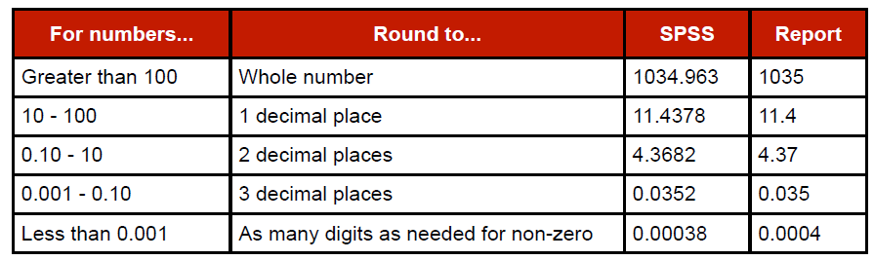
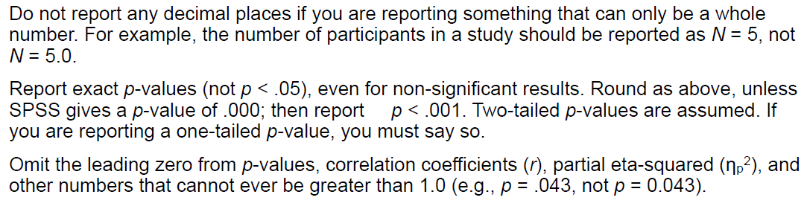
APA Format: numbers
IF: Number < 10 … THEN: write it out (“four” instead of 4)
Use zero “0” before decimal ( 0.25 instead of .25)

Slide 3
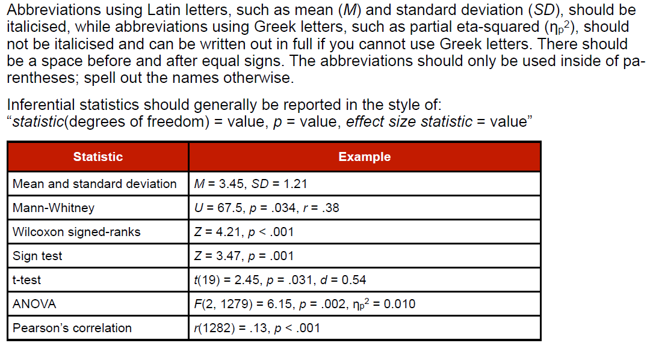
APA format: Abbreviations

Slide 4
APA format: analysis
Referencing analysis method?
common: no
Rare or new: yes
Descriptive statistics:
Abbreviations (spell out if not followed by stats)
OKAY: …scores were higher for males (M = 5, SD = 6)…
NOT: …the M was higher for males…
Inferential statistics :
Distributions, df, N (sometimes), tests statistics, p-values, effect size, …
t(32) = 4.75, p < 0.05, Cohen’s d = 0.87

Slide 5
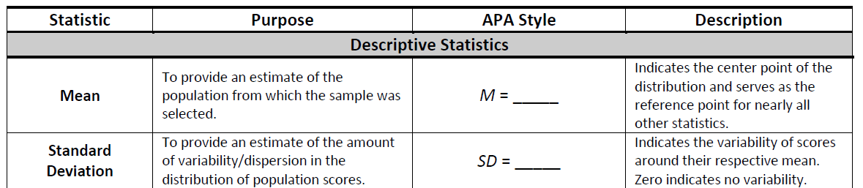
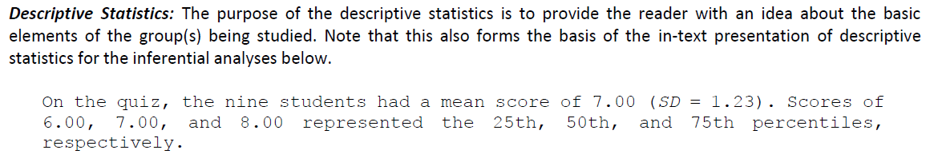
APA format: Analysis -examples

Slide 6
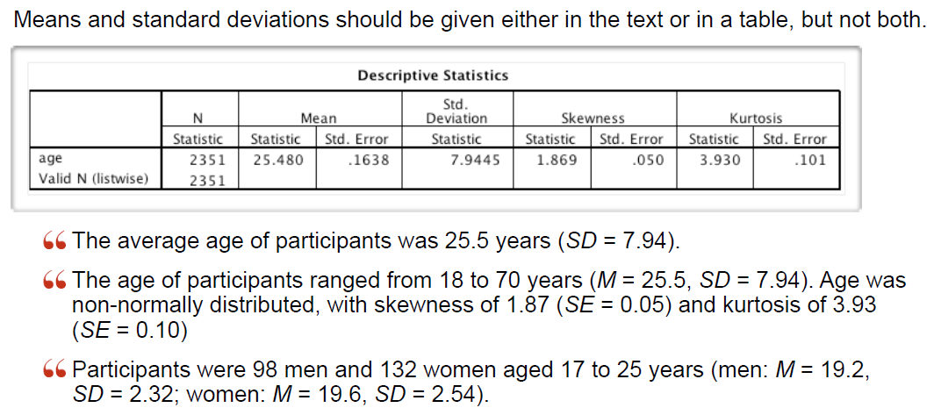
APA format: Analysis -examples

Slide 7
APA format: results
Results may presented as: text, tables, or figures
Rules of thumb:
TEXT if < 4 numbers/statistics
TABLE if 4 to 20 numbers/statistics
FIGURE if 20+ numbers/statistics
Pick the method that best communicates the results/message
Symbols & abbreviations
N vs. n
Italicized
See pages 141-144 of APA publication manual (reading “AR2” p 20-23)

Slide 8
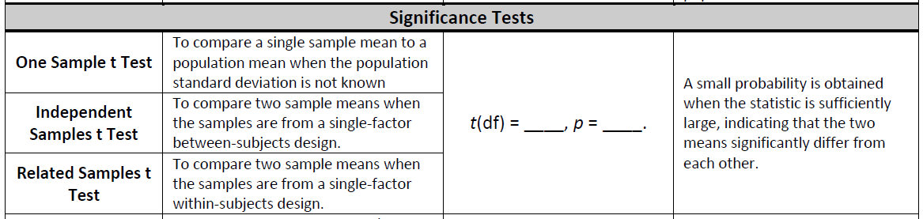
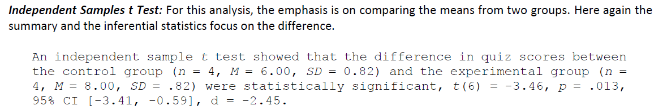
APA format: results - Examples

Slide 9
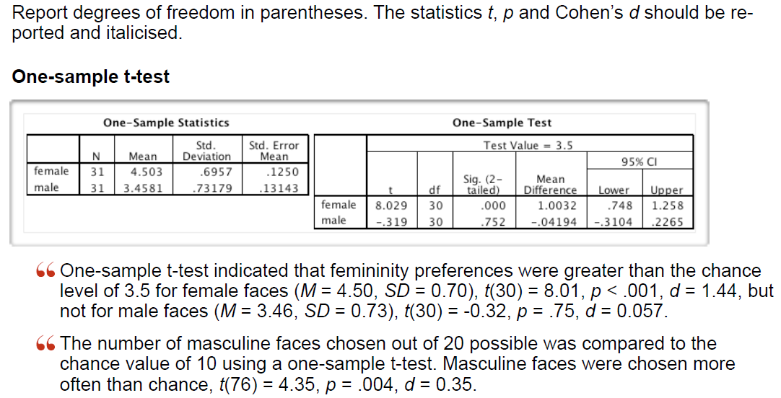
APA format: results - Examples

Slide 10
APA format: Tables
Must be able to stand on its own
Number tables sequentially in text (Table 1, Table 2, ect.)
Only 3-4 tables per manuscript (different for theses/disertations)
Results Table types
Descriptive statistics for N or n (or both)
Inferential statistics for ANOVA, MLR, ect.
Both descriptive AND inferential info in the same table…USE HEADINGS to organize
Data not applicable: leave blank
Data not obtained/not computable: use a dash “--”

Slide 11
APA format: Tables
Title (top)
Descriptive
First Letter of Each Word in CAPS
No period at the end
Appears on row below “Table 1”
Title may be italicized
Caption and Notes (bottom)
General Note
Explains/qualifies info in table, symbols, abbreviations
No explanation for basic stats (M, SD, no. N, n)
Specific Note
Begin on a new line, flush left
Define superscrits ^{a, b, c}
Probability note
Begin on a new line, flush left
* p < 0.05, ** p < 0.01, *** p < 0.001, **** p < 0.0001

Slide 12
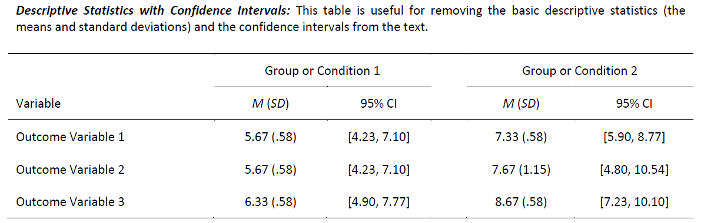
APA format: Tables - Examples

Slide 13
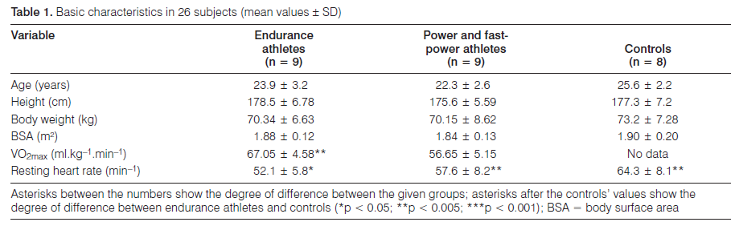
APA format: Tables - Examples

Slide 14
APA format: Figures
Includes: charts, graphs, photos, drawings, images, ect.
Must stand on its own: simple BUT illustrates a point
Number tables sequentially in text (Figure1, Figure2, ect.)
Caption
Appears below figure, immediately after “Figure 1” on same row
NOT a title, NOT capitalized
Brief, but descriptive explanation of figure
After 1st sentence, add clarifying info
Legend
Same font style and size as in figure

Slide 15
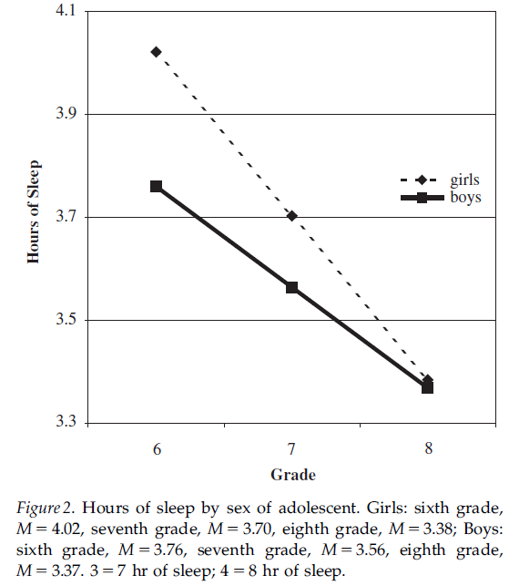
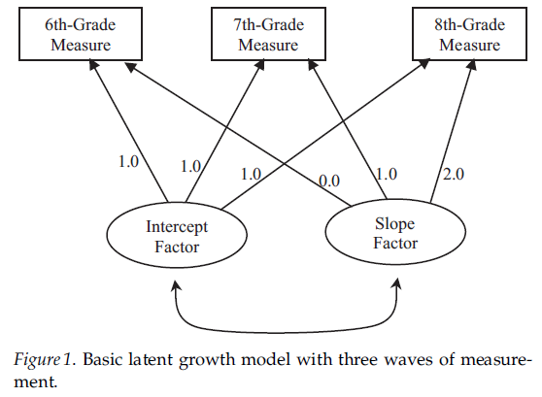
APA format: Figures - Examples

